Slide 1
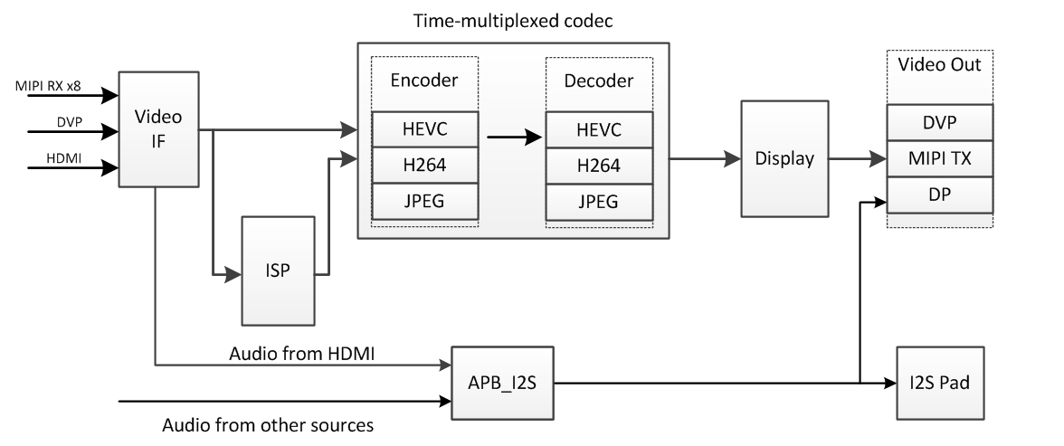
Veloce Build3 Testplan
Build3 System View

Slide 2
Video Input
3 Choices
MIPI RX
x8
input data could go to ISP directly
CCI - camera control interface
HDMI
w. audio channel (up to 8 channel)
HDCP
DVP
in & out multiplexed
Video from input to DDR/ISP via module video_if (Video Interface)

Slide 3
Test Plan – Video Input
Suggested testcases
Input sources should cover both 10b & 8b pixel.
 | X | Res./Freq. | Format | Destination | Notes
HDMI |  | 1080p/60Hz | RGB | DDR
 |  | 4k/30Hz | RGB | DDR
MIPI RX | x8 | 720p/30Hz (60Hz?) | RAW | DDR
 |  | 1080p/30Hz | RAW | ISP | ISP works in 4k/60Hz mode
 |  | 720p/30Hz (60Hz?) | YUV420 | DDR | ISP works in bypass mode
 | x2 | 1080p/60Hz |  | ISP
 | 2in1 | >4k | RAW | DDR | test max photo size supported
DVP | x1 | 1080p/60Hz | YUV422 | DDR | DVP: 16bit x1, SDR mode
 |  | 720p/60Hz x2 | YUV422 | DDR | 720p/60Hz x2
 | 1in, 1out | 720p/60Hz | YUV422 | DDR

Slide 4
Video Output
3 Choices
MIPI TX
x2 (4Lane)
CCI - camera control interface
DisplayPort
HDCP
DVP
in & out multiplexed

Slide 5
Test Plan – Video Output
Suggested testcases
 | X | Res./Freq. | Format | Notes
MIPI TX |  | 4k/30Hz | YUV420 / YUV422?
 |  | 1080p/60Hz | RGB
DVP | x1 | 1080p/60Hz |  | DVP: 16bit x1, SDR mode
 | 1in, 1out | 720p/60Hz
DP |  | 1080p/60Hz | RGB
 |  | 4k/30Hz | RGB

Slide 6
Testplan - HDMI Audio In / MIPI CCI / HDCP
HDMI Audio In
2ch audio in -> i2s pad
i2s DMA mode
2ch audio in -> video interface -> DDR
8ch: 2ch x 4
MIPI CCI
MIPI RX as master
MIPI TX as slave
HDCP
TX - DP
RX - HDMI

Slide 7
Test Plan – Video Codec – Encoding
H264 / HEVC
JPEG
Source | Format | Encoder | Decoder | Destination
ISP / VIF | ISP CF50, 8bit / 10bit | H264 (8bit only) or HEVC (8bit 10bit) | N/A | SD Card or USB
 | YUV420, planar, 8bit, little-endian
 | planar, 10bit, 1 pixel/2 Byte
 | planar, 10bit, 3 pixel/4 Byte
ISP / VIF 2 streams | 1080p@60Hz x2 | HEVC
 | 720p@60Hz x2 | H264
 | (*picture width: 16 pixel aligned)
Source | Format | Encoder | Decoder | Destination
ISP / VIF | 8bit, YUV444/YUV422/YUV420 | JPEG | N/A | SD Card or USB (To BB: in Build4)
 | 10bit, YUV444/YUV422/YUV420
 | 12bit, YUV422

Slide 8
Test Plan – Video Codec, Display
Low Latency Interface of H264 / HEVC
Display
Source | Format | Encoder | Decoder | Destination
ISP / VIF | <low latency (for scenario with BB)> | H264 | N/A | SD Card or USB (To BB: in Build4)
 |  | HEVC
Source | Format | Encoder | Decoder | Destination
ISP / VIF | YUV, 8bit, planar | N/A | N/A | DISPLAY-> DP (4k/30Hz) / MIPI (4k/30Hz) / DVP (1080p/60Hz)
 | RGB, 8bit
 | YUV, 10bit, 3 pixel/4 Byte
 | YUV, 10bit, 1 pixel/2 Byte
 | Scaling up/down

Slide 9
Testplan - from Video Input to Video Output
H264 & HEVC
Test with BB - in Build 4
Video In |  | Format | Encoder | Decoder | Video Out
HDMI/MIPI/DVP | ISP / VIF | 8bit | H264 | H264 | DISP->DP/MIPI/DVP
 |  | 10bit | HEVC | HEVC
Video In | Format | Encoder |  |  | Decoder | Video Out
HDMI/MIPI/DVP → ISP/VIF | 8bit | H264 | BB TX → | → BB RX | H264 | DISP → DP/MIPI/DVP
 | 10bit | HEVC |  |  | HEVC
S i r i u s C h i p 1 |  |  |  | S i r i u s C h i p 2

Slide 10
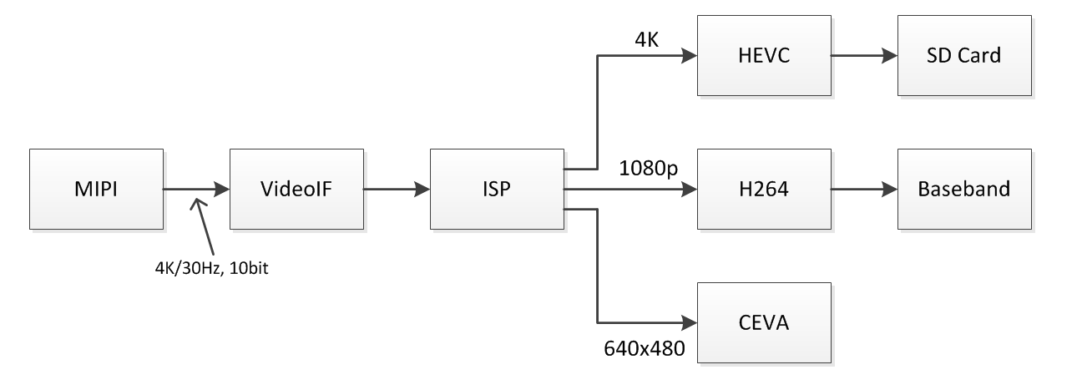
Testplan - ISP
Scenario 1 - Drones (output 3 resolution)

Slide 11
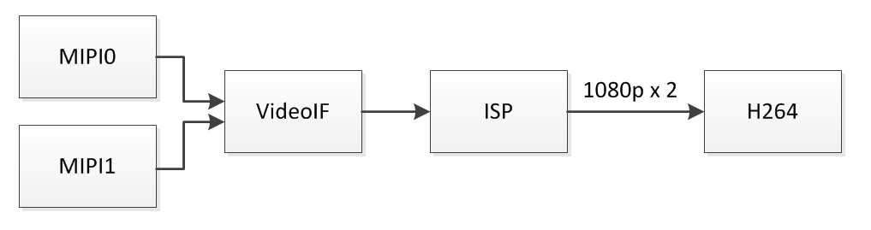
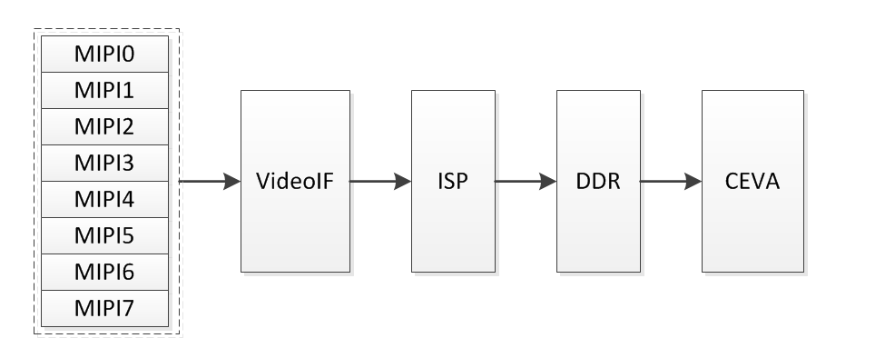
Testplan - ISP
Scenario 2 - Binocular Vision
Scenario 3 - Panorama

Slide 12
Testplan - SMMU / TZC / H264 Shared SRAM
SMMU-Video functions
Page Table Walk
SMMU invalidation
TZC functions
For DDR port #4 & #5
H264 Shared SRAM
Accessed by other masters when H264 is not active
A7, HEVC, DMA

